Slide 1
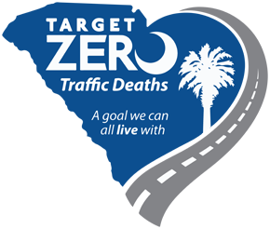
Getting to Zero Roadway Fatalities

Slide 2

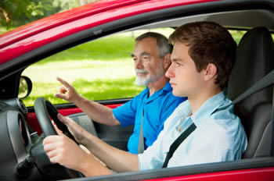
Motor Vehicle Crashes
#1 cause of death for ages 5-24
Notes:
Preventable injuries are the 3rd leading cause of death, and motor vehicle crashes are a huge contributor to preventable injuries.
Motor vehicle crashes are the leading cause of death for people from age 5 -24.

Slide 3
United States
Crime Crash Clock (2016)
Crime
47 murders
each day
Crashes
100 fatalities
each day
Notes:
Everyday in the US, more than double the number of people are killed in motor vehicle related crashes than murdered- but what seems to get more attention both politically and publicly? Crime or crashes?

Slide 4

HOW DO WE SHIFT CULTURE?
Notes:
We experienced 37, 461 road fatalities in 2016
In Texas, there has not be a single day without a roadway fatality since November 2000. Almost 18 years!
Something must change.
How do we move people – where people believe the crashes are preventable and unacceptable. How do we shift culture?

Slide 5

What Can We Do?
Crashes are caused by the alignment of factors that can be both ANTICIPATED and ALTERED.
Notes:
Crashes are caused by the alignment of factors that can be both anticipated and altered, therefore if crashes can be anticipated they are predictable and if they can be altered, they are controllable!
Crashes are not accidents, the definition of an accident is an event that happens by chance or without apparent or deliberate cause. Synonyms of the word accident are by chance, coincidence, twist of fate, freak. These words do not describe a crash.

Slide 6


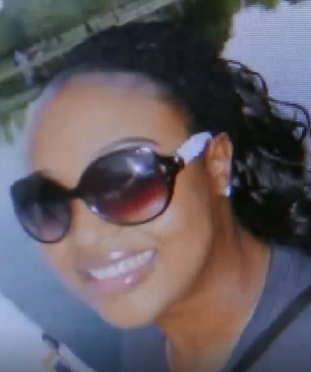
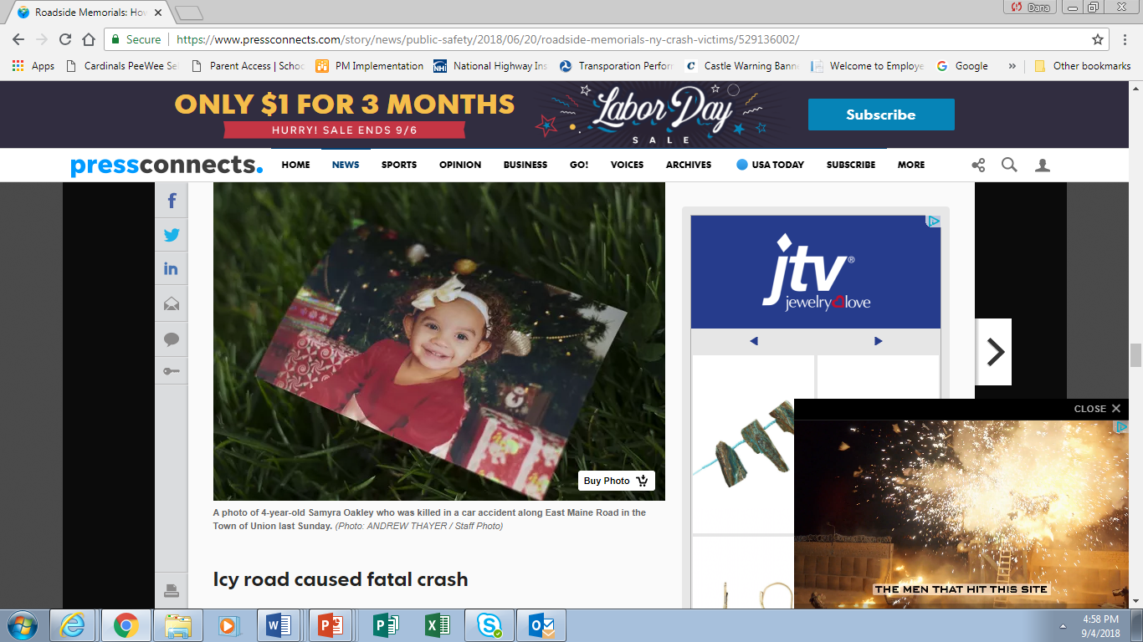
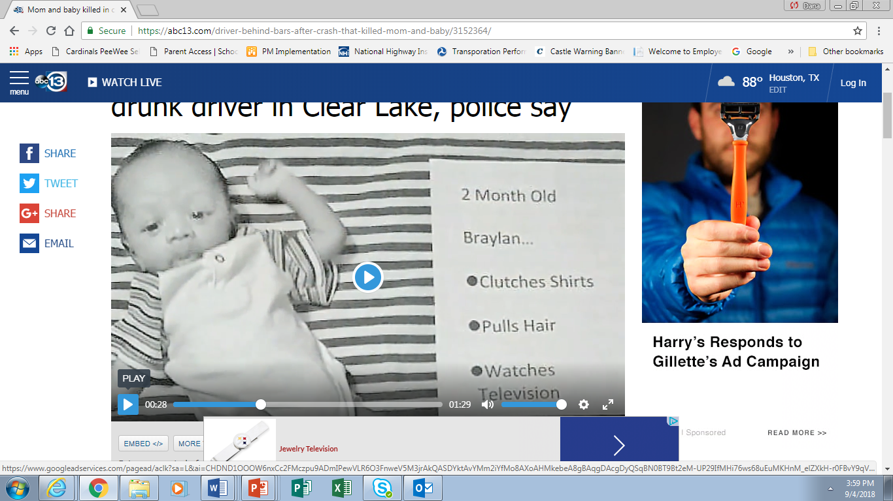
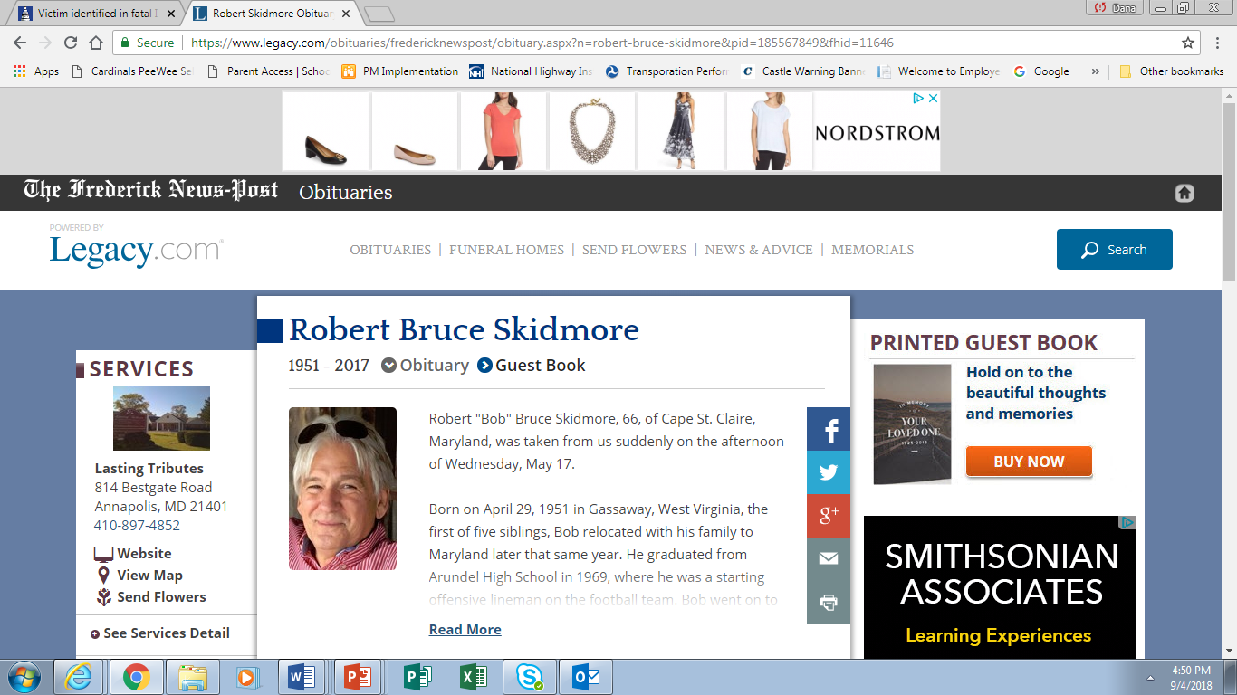

Notes:
In highway safety, we quote a lot of statistics, numbers are used as a way to measure outcomes, but the lives lost in crashes are not just numbers, they are parents, children, brothers, sisters, friends and co-workers. The impact of their loss is very real and devastating to families and communities.
Behind these numbers are real people like
36 year old Sheyla Joseph (Houston, TX) and her 3 month old daughter Braylan
Isabella Garcia, age 16 from Jacksonville FL
Robert Skidmore, age 66 of Cape St. Claire Maryland
4 year old Samyra Oakley from Johnson City, NY
Emma Beckwith age 61 from Florence, Alabama
Let’s work diligently to prevent the needless tragedies that occur on our roads each day.

Slide 7
WE CAN MAKE A DIFFERENCE?
WHAT IS THE RIGHT NUMBER?
100 Traffic Deaths
per day
in the U.S.
Notes:
We need to get serious about the 100 roadway fatalities we experience EVERY SINGLE DAY.
These crashes tend to be accepted as a price for our mobility.
Making the shift to a culture where ZERO is the only appropriate answer isn’t easy. FHWA, along with many of our partners have put together a vision to get us there and I am going to share that vision with you today.

Slide 8

DOUBLE DOWN
on What Works
ACCELERATE Technology
PRIORITIZE
Safety
Notes:
With the help from RTZ Coalition members and the RAND Corporation, a report was published to help chart the course to ending roadway fatalities by 2050.
The report breaks down how we can get to zero by focusing on three things:
Doubling down on what works
Accelerating technology
And implementing a Safe Systems Approach – Promoting Safety

Slide 9
DOUBLE
DOWN
ON
WHAT WORKS
ADVANCE
PROVEN COUNTER-MEASURES
Notes:
Step One is Double Down on What Works through proven countermeasures.
This is the area where most of us are making a difference right now.
Pushing” Safety Innovations today is key to doubling down on what works

Slide 10
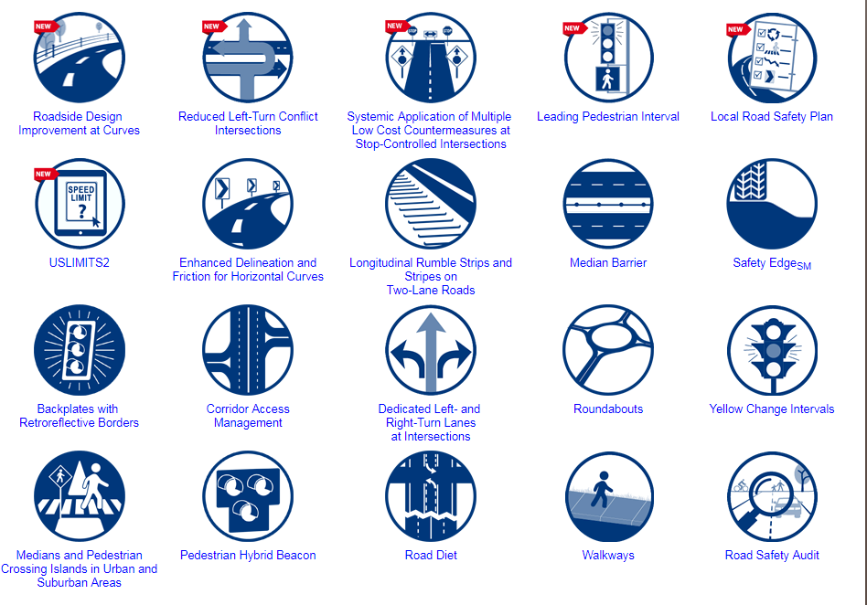
FHWA’s Proven Safety Countermeasures
Notes:
How many proven safety countermeasures has your State implemented?
Safety EdgeSM
High-Friction Surface Treatments
Innovative Intersection & Interchange Design
Road Diets
Enhanced Pedestrian Crossings at Uncontrolled Locations
Are we pushing these aggressively? States should rapidly deploy more on roads that need them the most (saturate)

Slide 11
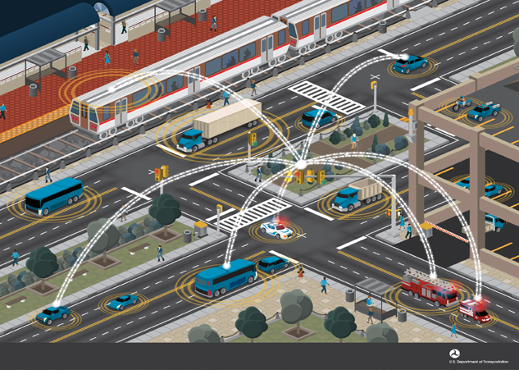
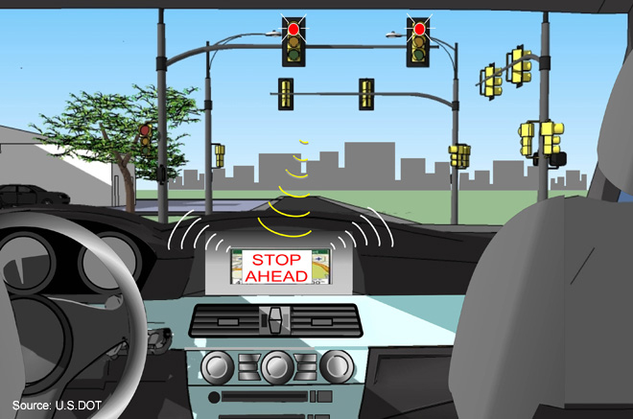
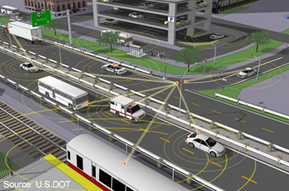
ACCELERATE TECHNOLOGY
Notes:
We know that emerging technologies promise large advances in safety. More and more vehicle manufacturers are introducing technologies into their fleet. We are going to see more connectivity and infrastructure technology deployment in the near future.
Technology where connected vehicles connect at intersections
Warning messages that a car is approaching a traffic signal
And wireless connection will even allow connectivity between all modes of transportation
How are we helping our States to prepare for this?

Slide 12
PRIORITIZE
SAFETY
CREATE
A SAFE SYSTEMS APPROACH TO
SHIFT
CULTURE
Notes:
The 3rd, and most important step is to ensure we put safety at the center of every transportation decision.
We demand 100% safe operations in aviation, marine, pipeline, rail and transit, we should cultivate a corresponding societal demand for safe roads. The U.S. is trailing our international counterparts in addressing road safety. It’s because safety is not yet our #1 priority.
We know humans make mistakes, but we can design our systems in such a way that will make the likelihood of deadly mistakes near zero.

Slide 13
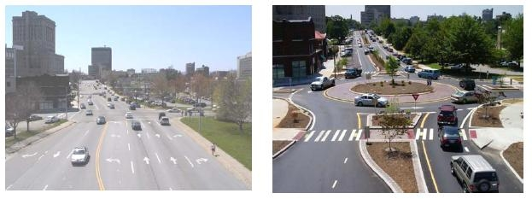
Asheville, North Carolina
Safe Infrastructure Project
7 lanes of traffic reduced to single lane roundabout:
              pedestrians cross just one lane at a time
              lower speeds
              shorter queues
              better use of space
Notes:
Vision Zero cities and others who have taken the safe systems approach have saved lives by redesigning dangerous corridors and crash-prone intersections.
Infrastructure improvements, automated enforcement, adjusting speed limits and traffic signal timing have created a safer road environments for the most vulnerable road users such as bicyclists and pedestrians.

Slide 14
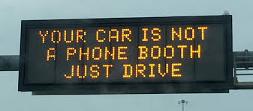
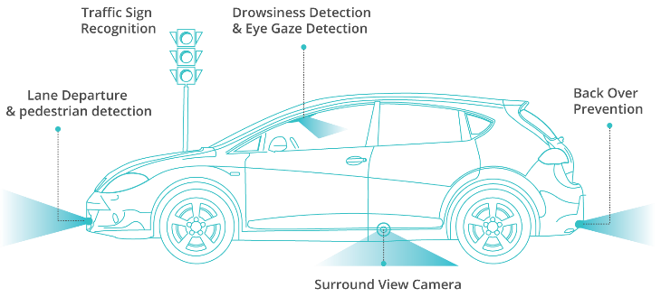
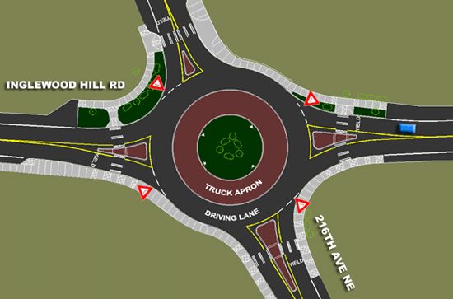
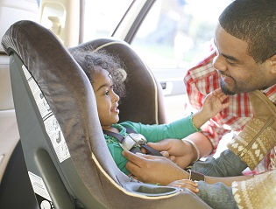
THE FUTURE OF ZERO
Notes:
We have to work to change the culture by seeing all components in our transportation system through a safety lens : Human, Machine, Environment, and Safety Culture.

